Slide 1
What I Learned About Life from Being a Content Publisher for
10 Years

Slide 2
agenda
INTRODUCTION 1
LIFE LESSONS 2
FINAL TIPS & TAKEAWAYS 3

Slide 3

When I started as a content publisher, I thought my job was just to push text and images online. 10 years later, I realize—it taught me patience, clarity, teamwork, and even humility.

Slide 4

Life lessons
“After 10 years of fixing typos, chasing deadlines, and publishing thousands of pages… I discovered something unexpected — life lessons.”

Slide 5

1. Attention to Detail is a Superpower
“One typo can damage credibility. One broken link can break trust.”
Just like Spider-Man, whose web-slinging precision saves lives, as content publishers, we work behind the scenes—making sure every piece of content is sharp, clean, and perfectly placed.
In our world, attention to detail builds digital trust—one pixel at a time.

Slide 6
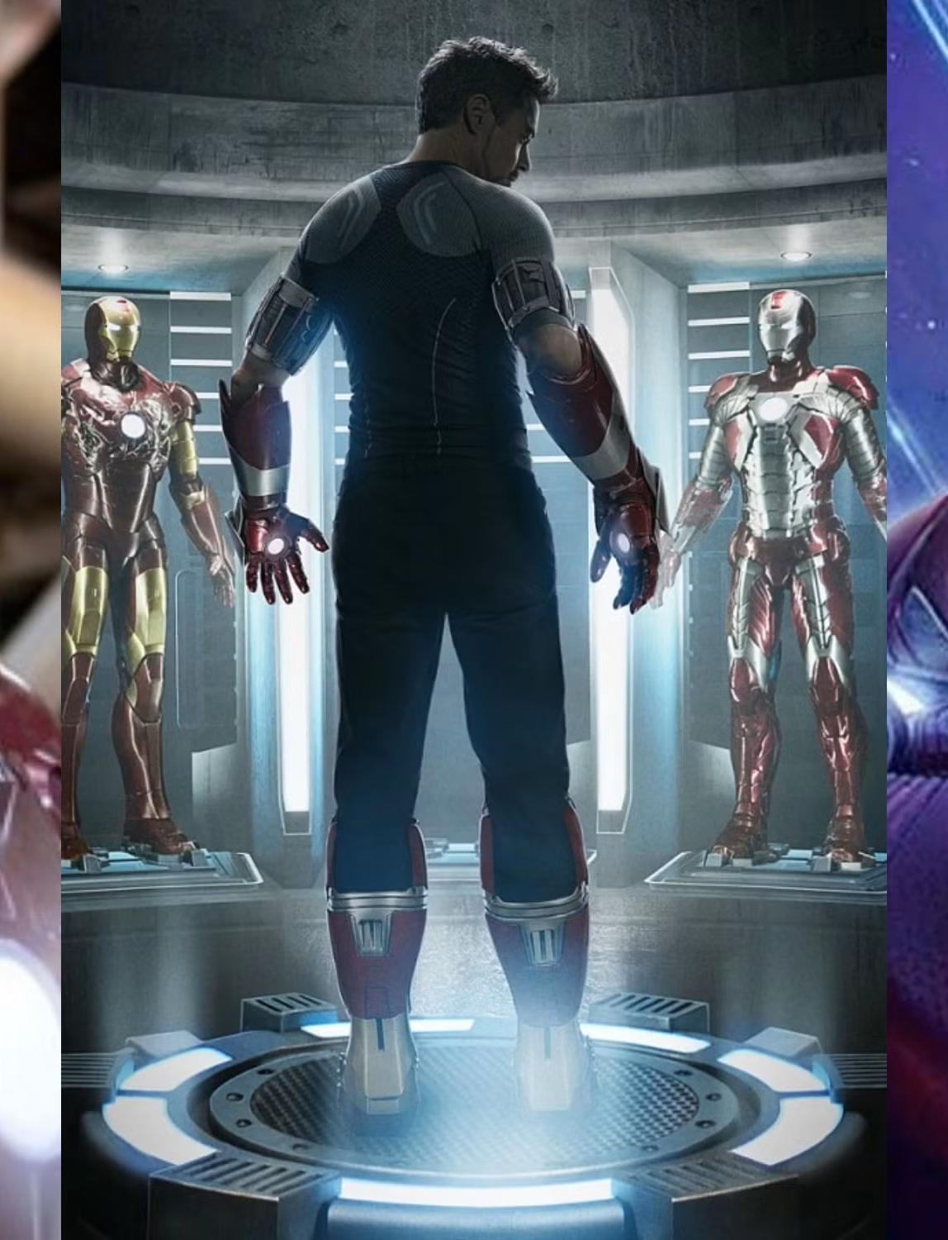
2. Change is the Only Constant
“Tools change. Designs change. Guidelines evolve.
Just like storylines in the MCU.”
Think of Tony Stark—constantly upgrading his suits, adapting to new threats, and evolving his tech.
To stay relevant, like Iron Man, we must evolve with the system, tools, and expectations.

Slide 7
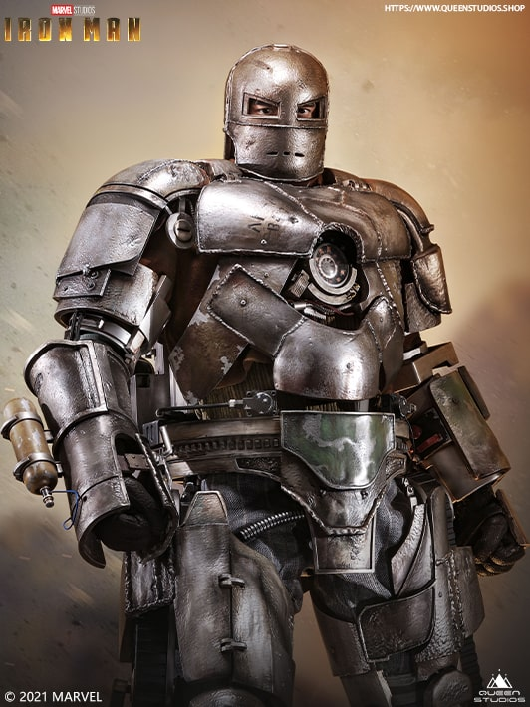
3. Perfection is a Myth – Go Live Anyway
“Every piece of content can be improved forever. But deadlines teach us to publish and move forward.”
Remember Iron Man’s first suit? It was bulky and imperfect—but it worked.
If Tony had waited to perfect it, he’d still be in that cave.
In content, and life, progress > perfection.
Ship it. Learn. Improve.

Slide 8
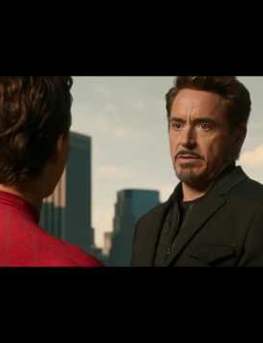
4. Feedback is Not a Personal Attack
“Clients reject pages. Reviewers give harsh comments. But it’s part of the process.”
Even Spider-Man had to hear tough feedback from Tony Stark:
“If you’re nothing without the suit, then you shouldn’t have it.”
Feedback, even when uncomfortable, helps us level up.

Slide 9

5. Teamwork Makes Everything Possible
“Pages go live because writers, designers, developers, QA, and content publishers work as one.”
Just like the Avengers—each has a role, and victory comes only through unity.
Captain America may be the leader, but without Black Widow, Hulk, or Thor, the mission fails.
Respect every role—visible or invisible. Great things are built together.

Slide 10
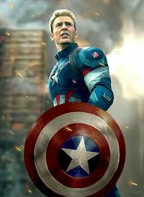
6. Deadlines Teach Discipline
“Publishing may be creative—but it’s driven by timelines.”
Think of Captain America—a symbol of discipline and duty.
While others improvise, Cap sticks to principles and timing. That’s what makes him dependable.
Discipline isn’t boring—it’s what turns goals into achievements.

Slide 11

7. You Don’t Always Get Credit – And That’s Okay
“We hit publish. The page works. But nobody knows who did it—and that’s fine.”
Like Black Widow, who quietly contributes to every mission, sacrifices big, but rarely gets the spotlight.
She’s not the loudest Avenger—but without her, many victories wouldn’t happen.
Value is not always loud. Silent contribution is still contribution.

Slide 12
Bonus tips

Slide 13
“Being a content publisher is like being a behind-the-scenes Avenger.
You don’t fly. You don’t throw hammers. But you make sure the mission succeeds—one task, one detail, one deadline at a time.”
“Not all heroes wear capes, suits—some wear headphones, fix line breaks, and publish pages at 11:59 PM.”

Slide 14
thank you
Presented by - Jogendra PAl
You can download the presentation from our official website.
Download

